Slide 1

Roberto Ramírez Monroy A01366943
Alitzel Macías Infante A01373166

Slide 2

Business Understanding
A key in students learning is the teacher’s knowledge of the subject, the ability to implement new strategies, to design appropriate tools, and to address different learning styles.
The analysis of feedback from students about professor’s methods of teaching can give insights in weaknesses and strengths of specific subjects.
Stakeholders: Tecnológico de Monterrey, other academic institutions, and educational investigation researchers.

Slide 3
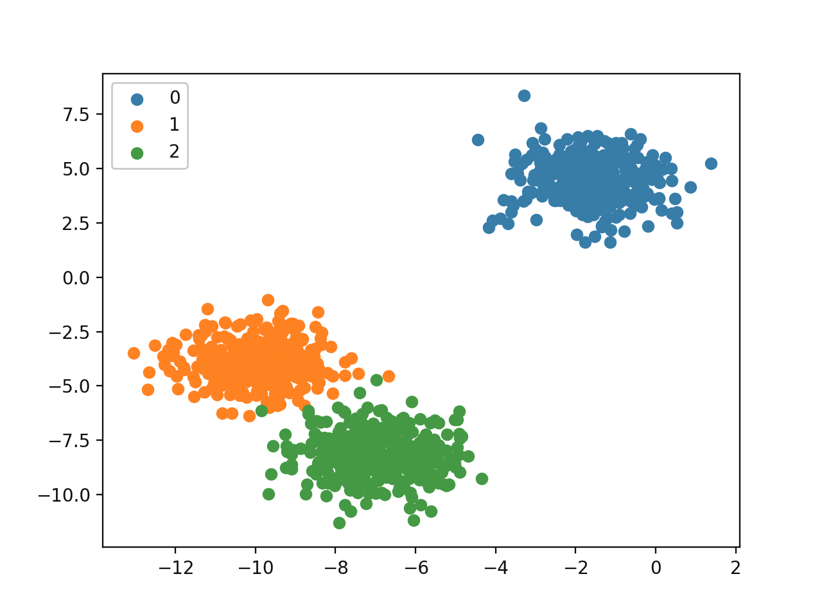
Related Work
Mohamed et al. use 4 classifiers: Decision Trees, Multilayer Perception, Naive Bayes, and Sequential Minimal Optimization to predict the instructor performance and investigate the factors that affect students’ achievements. [1]
Gündüz et al. use techniques such as SVM, classification and regression trees, random forest, KMeans clustering, among others, to investigate the relationship between the difficulty of a course and the rating students give to the instructor. They found a correlation between the student’s dedication and the scores they tend to assign to their instructors. [2]

Slide 4
Related Work
Kandhro et al. used sentiment analysis to analyze students’ evaluations through a LSTM model. Although they did not use the obtained model to find correlations between the data, this model is useful for this future kind of analysis. [3]
Ceballos et al. used ECOAs to compare the teaching performance of only teachers vs research teachers. The results were that both groups perform similarly; however, there were differences depending on attributes such as the professor’s age, gender, and research level. [4]

Slide 5
Proposal
Analyze what teachers’ competences students care more about, and whether these competences depend on factors such as the campus of the school, the taught subject, or the department or group of the teacher.
Independent Variables:
Campus
Department
Subject
Sentiment
Dependent Variable:
Subcategory: It is related to the aspect of the professor’s way of teaching that the student is commenting on.

Slide 6
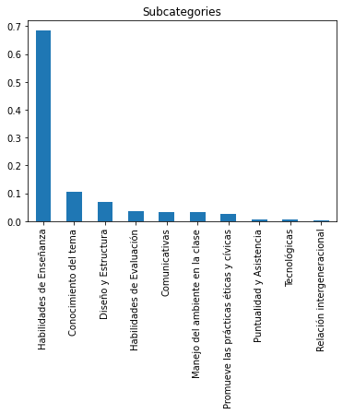
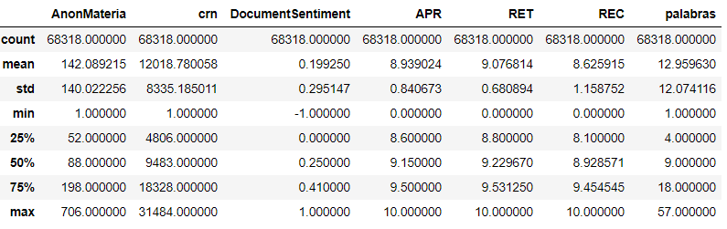
Data
Datasource Description
Data preparation

Slide 7
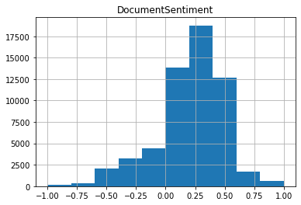
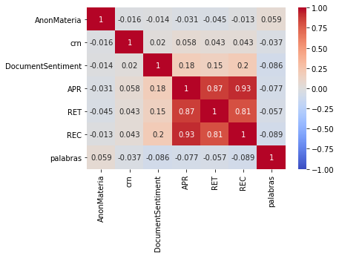
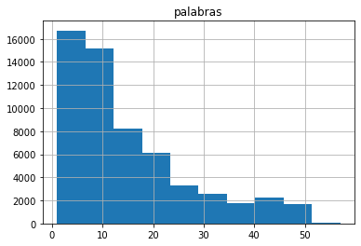
Descriptive Analysis

Slide 8

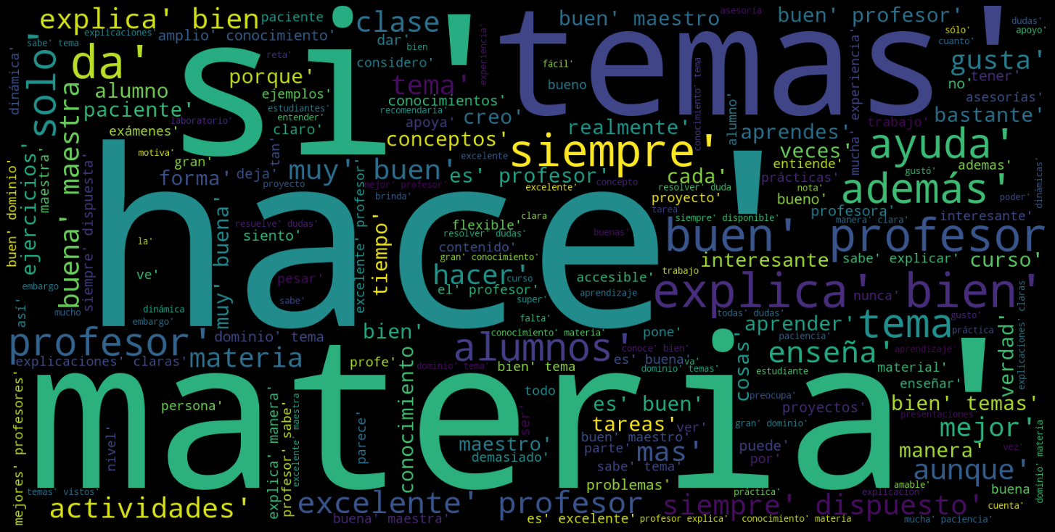
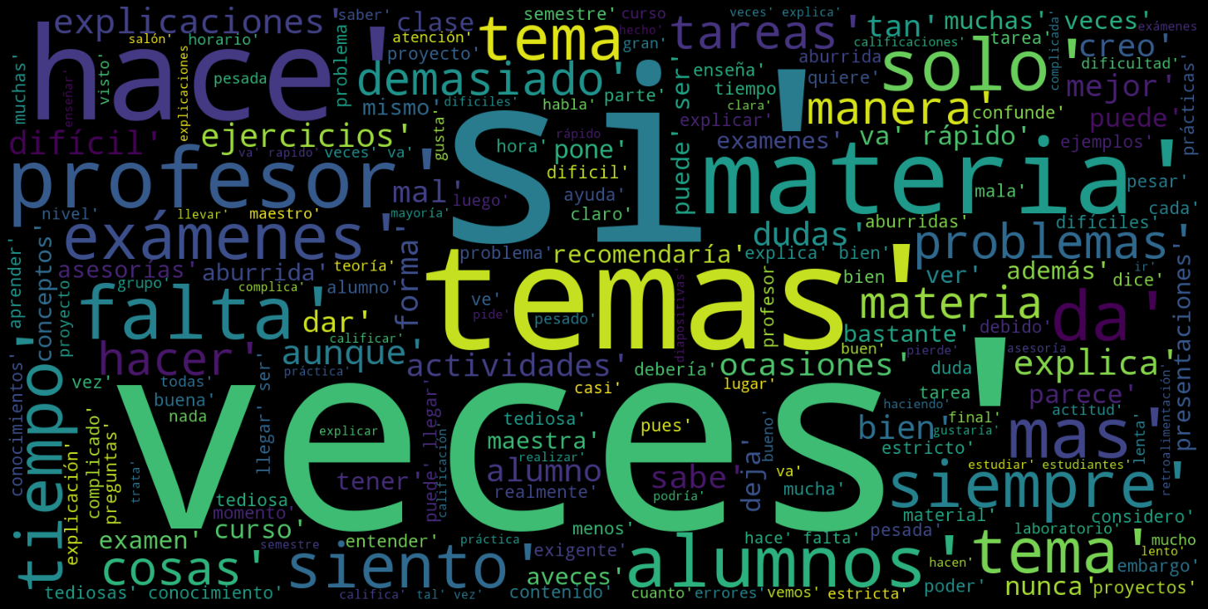

Slide 9
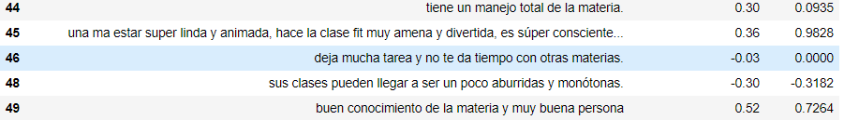
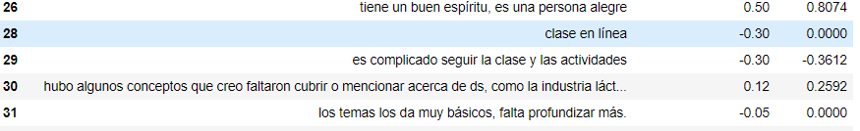
New score?

Slide 10
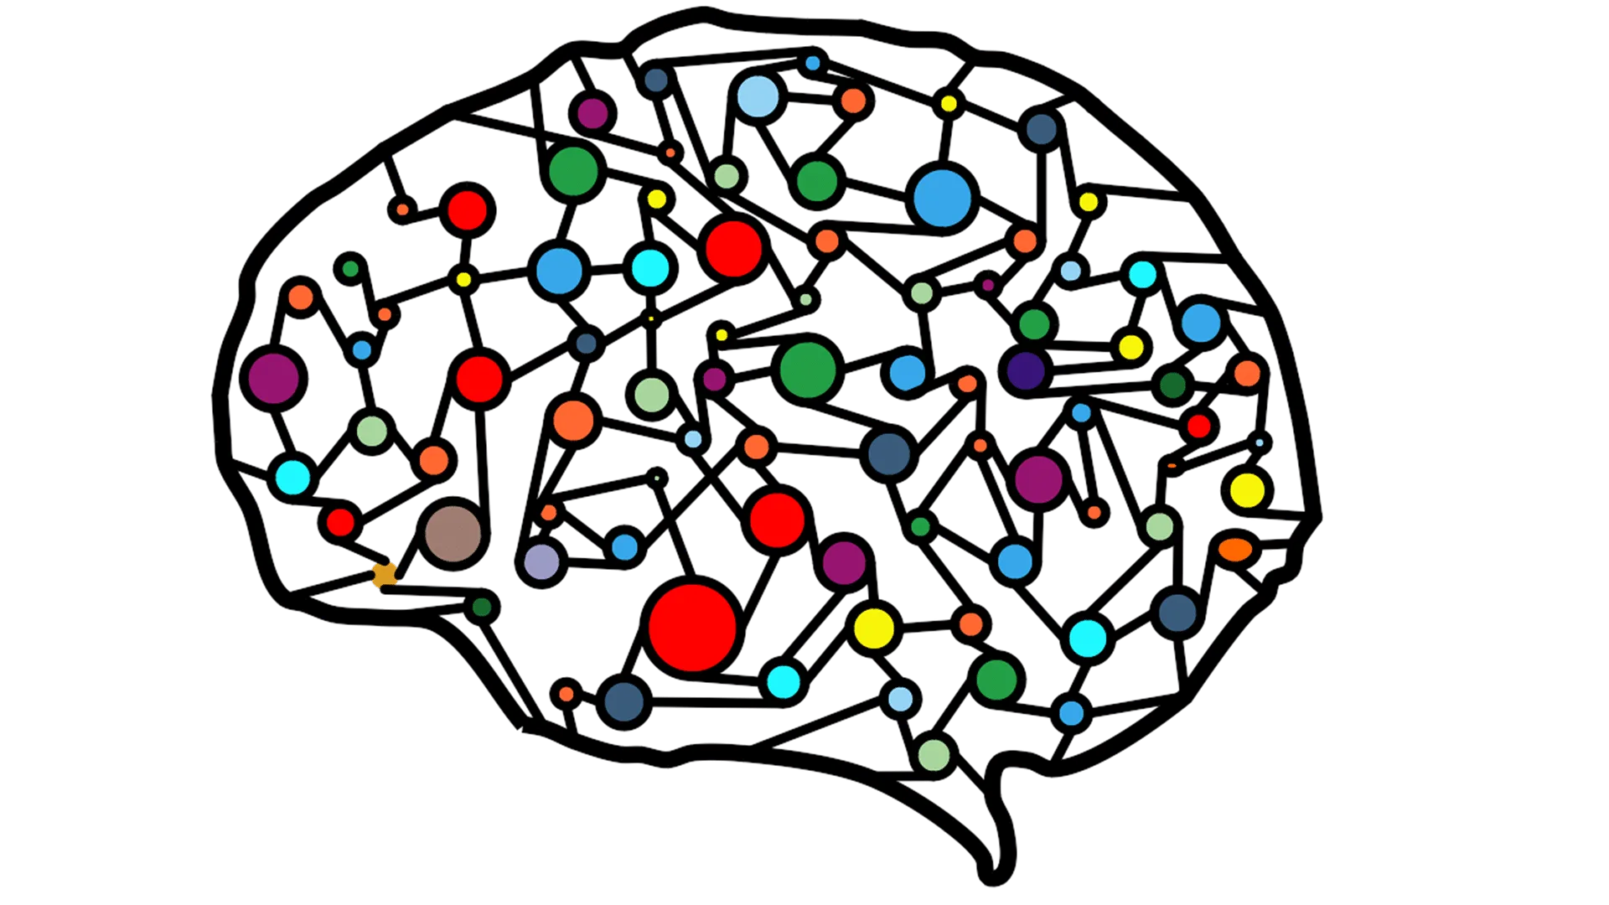
ML Techniques to apply
The first proposal of technique to apply in order to answer the question we are targeting, is to use an Artificial Neural Network, where the input would be some information of the subject, the sentiment of the evaluation and more data we could get or create, to predict the category/subcategory of the evaluation, so then we could know the opportunity areas of improvement or the strengths of the teacher, helping them improve the way they teach.

Slide 11
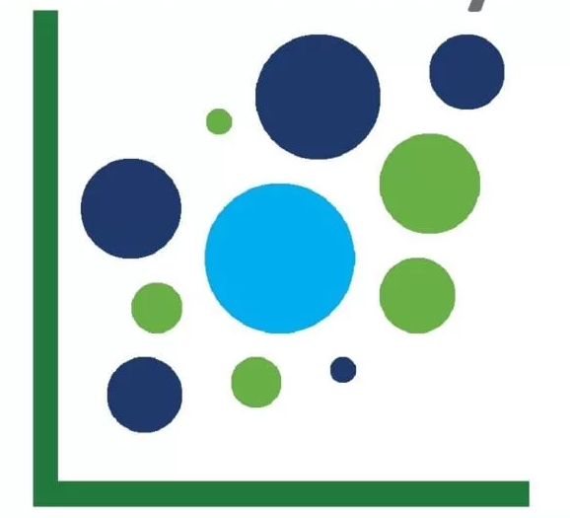
ML Techniques to apply
Also we could implement some kind of clusterization to know if there are more categories that the comments could be categorized in, as right now we only have 3 predefined categories.

Slide 12
References
[1] A. Mohamed, A. Rizaner, and A. Hakan, Using data mining to predict instructor performance, Procedia Computer Science 102, pp. 137-142, 2016, DOI:10.1016/j.procs.2016.09.380.
[2] N. Gündüz and E. Fokoué, Pattern Discovery in Students’ Evaluations of Professors A Statistical Data Mining Approach, Journal of Applied Statistics, 2015, http://arxiv.org/abs/1501.02263v1.
[3] I. Kandhro, S. Wasi, K. Kumar, M. Rind, and M. Ameen, Sentiment Analysis of Students’ Comment by using Long-Short Term Model, Indian Journal of Science and Technology, vol 12(8) pp. 1-16, 2019, DOI:10.17485/ijst/2019/v12i8/141741.
[4] H. Ceballos, M. Chavez, and F. Cantu, A Data Analytics Approach to Contrast the Performance of Teaching (only) vs Research Professors, International Journal on Interactive Design and Manufacturing, Unpublished.

